Slide 1

Gokaraju Rangaraju Institute Of Engineering & Technology
Bachupally, Kukatpally, Hyderabad- 500090
DEPARTMENT OF INFORMATION TECHNOLOGY
MAJOR PROJECT ABSTRACT PRESENTATION
On
BITCOIN PRICE PREDICTION USING MACHINE LEARNING
BATCH NO:12
Name Roll Numbers
1. D Karthik 18241A1275
2. N Sai Sujith 18241A1298
3. J Ganesh 18241A1282
4. G Lokesh Reddy 18241A1281
5. V Sharath 18241A12B7
Under the guidance of
Project Guide
Deepika Borgaonkar
Assistant Professor
Head of the Department
Dr. K. Prasanna Lakshmi

Slide 2
UML DIAGRAMS

Slide 3
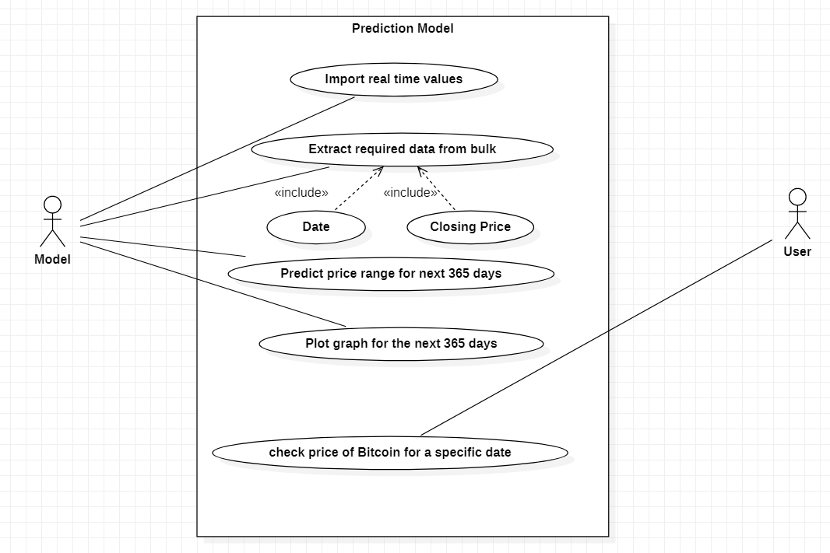
USE CASE DIAGRAM

Slide 4
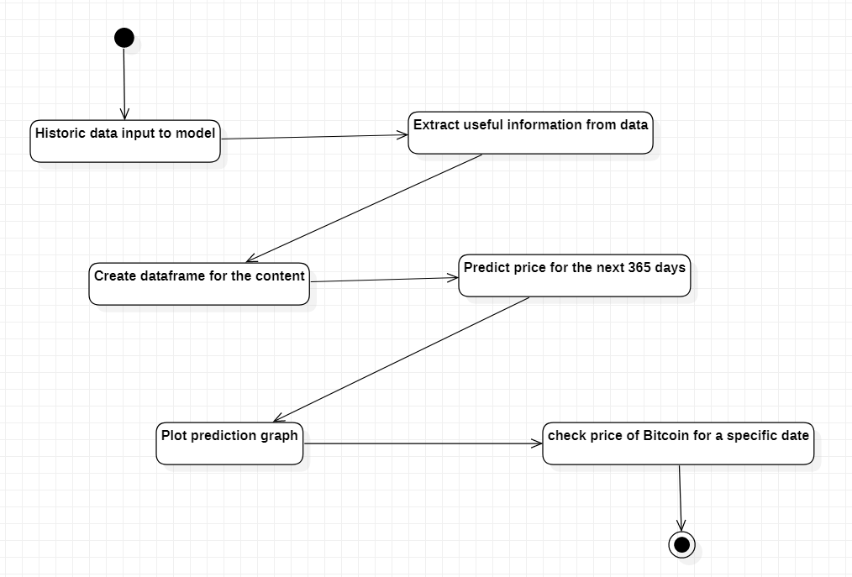
ACTIVITY DIAGRAM

Slide 5
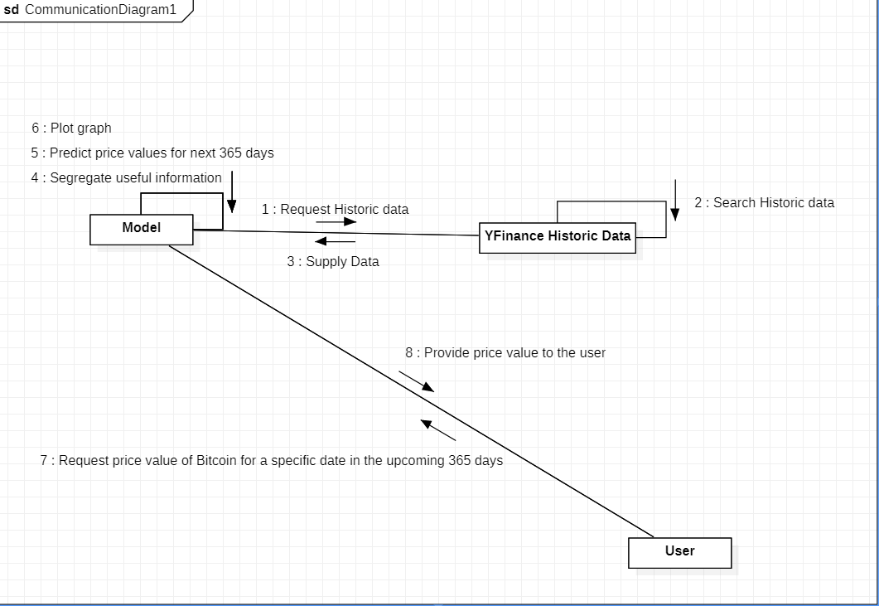
COMMUNICATION DIAGRAM

Slide 6
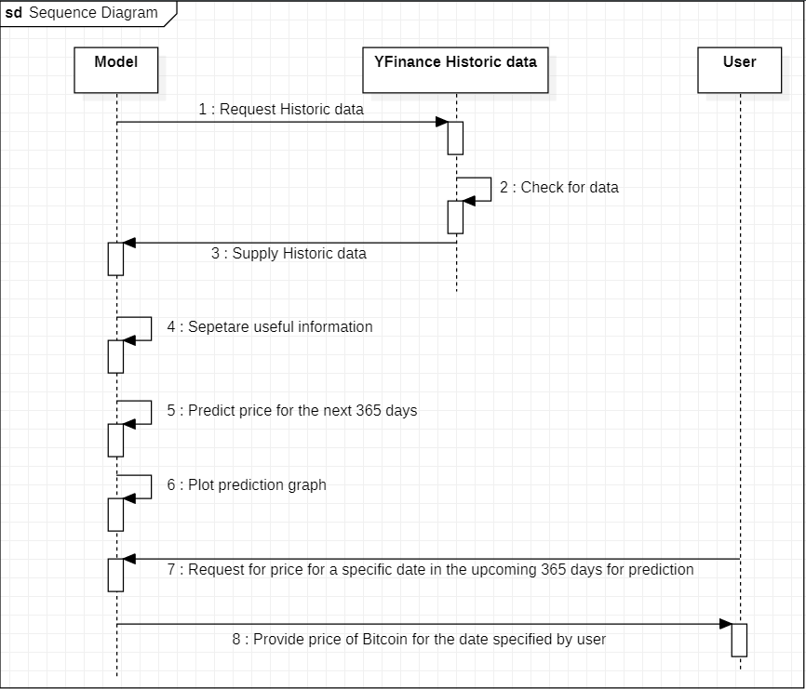
SEQUENCE DIAGRAM

Slide 7
THANK YOU

